Slide 1
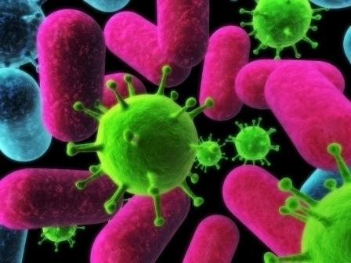
Infectious Diseases
Steven M. Standaert M.D.

Slide 2
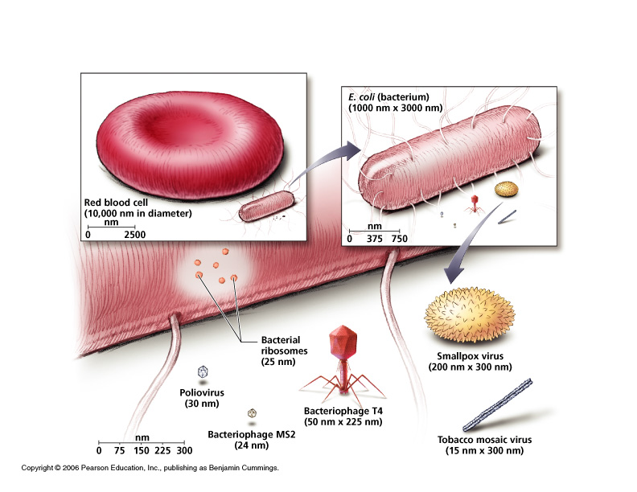

Slide 3
Etiologies of Various Infections
Virus | Bacteria | Fungus | Parasite
Chickenpox (Varicella) | Strep Throat (GAS) | Thrush | Malaria
Shingles (Zoster) | Gonorrhea | Vaginal Yeast | Giardia
Smallpox (Variola) | Chlamydia | Valley Fever | Sleeping Sickness
Measles | Syphilis | Athlete’s Feet | Trichamonus
Mumps | Plague | Ringworm | Toxoplasmosis
Mononucleosis (EBV) | Tuberculosis
HIV/AIDS | Cholera
Hepatitis A, B and C | Legionnaires Disease
Fever Blisters (HSV 1) | Pertussis
Flu (Influenza) | Leprosy
Common Cold (many) | Anthrax
Polio (Poliovirus) | Lyme Disease
Warts/Cervical Ca (HPV) | Cat Scratch Disease
Rabies | MRSA

Slide 4
Natural History of Infections
Initial exposure
Incubation period
Illness onset
Duration
Acute – hours to days
Subacute - weeks
Chronic – months to years
Recovery, Recurrence or Death

Slide 5
Treatment
Antibiotics
Antivirals - HIV medications, acyclovir
Antibacterial - Penicillin, erythromycin
Antifungals - Miconazole, fluconazole
Antiparasitic - Ivermectin, chloroquine
Active Immunization
Dead virus, whole or part - MMR, HPV, DPT, injectable polio
Alive or attenuated - Varicella, oral polio
Passive immunization
Intravenous immunoglobin, Rabies Immunoglobin,
horse serum
Immunomodulators
Interferon, Prednisone
Tincture of Time

Slide 6
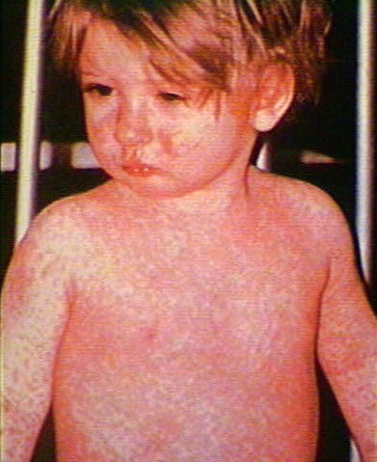

Slide 7
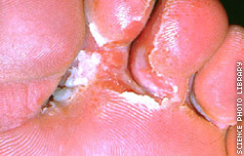

Slide 8
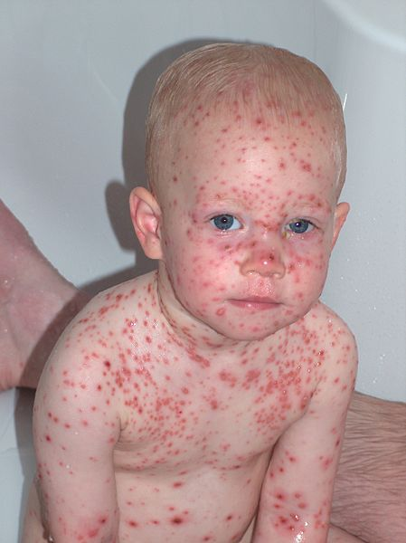

Slide 9
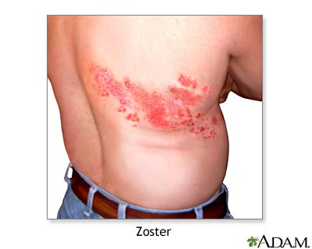

Slide 10
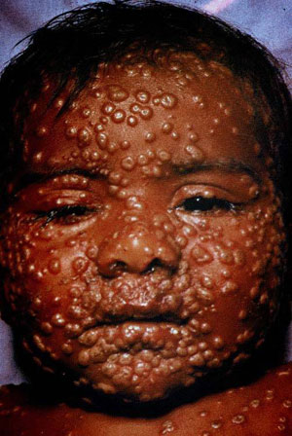

Slide 11
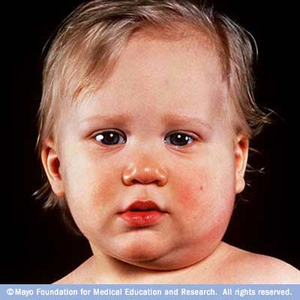

Slide 12
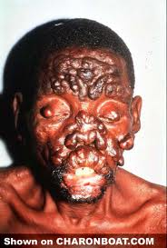

Slide 13
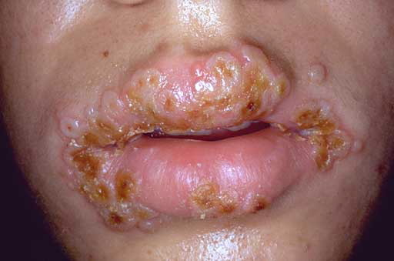

Slide 14
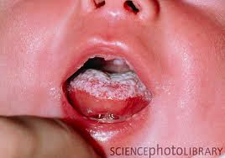

Slide 15
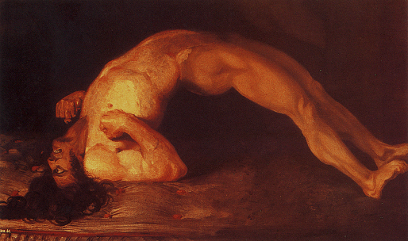

Slide 16
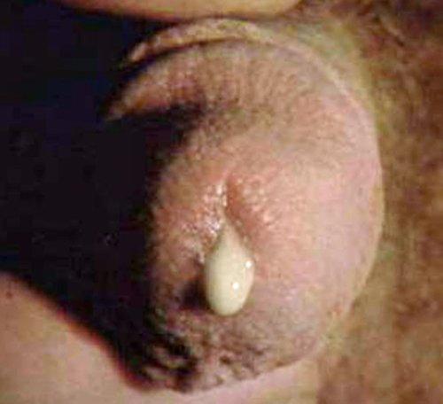

Slide 17
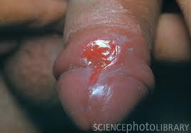

Slide 18
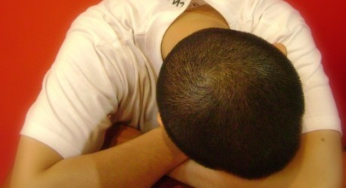

Slide 19
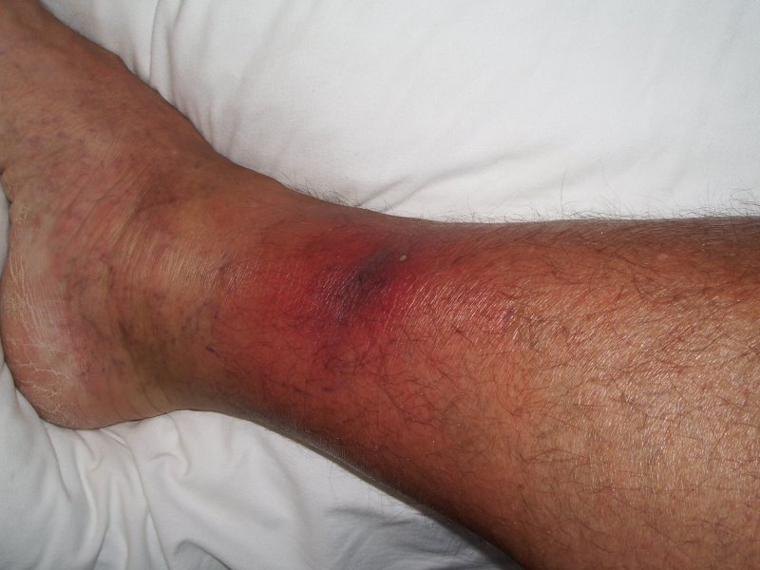

Slide 20
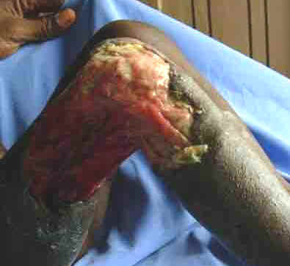

Slide 21
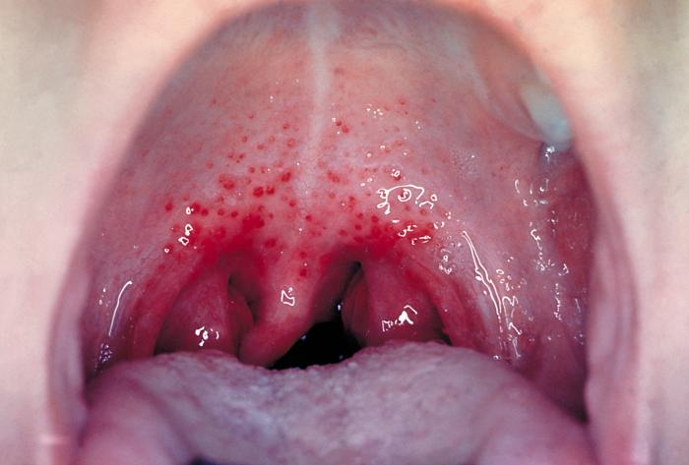

Slide 22
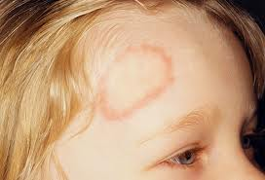

Slide 23
